Slide 1

9. Configure DNS
Windows Server 2019 Basics

Slide 2
Tasks
Create a Reverse Lookup Zone
Explore the DNS console

Slide 3
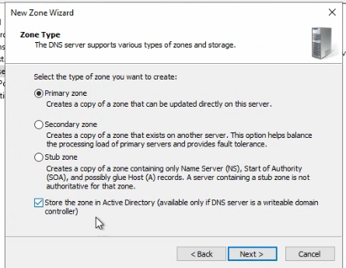
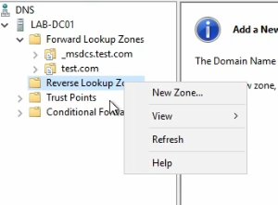
Create reverse lookup zone
Notes:
In the DNS console just right click on Reverse Lookup Zones and select New Zone.
Select Primary zone and make sure the check box for Active Directory is checked.

Slide 4
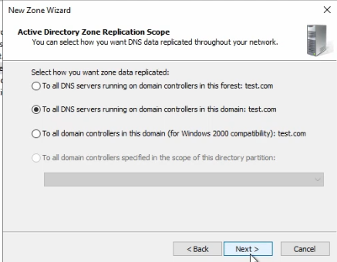
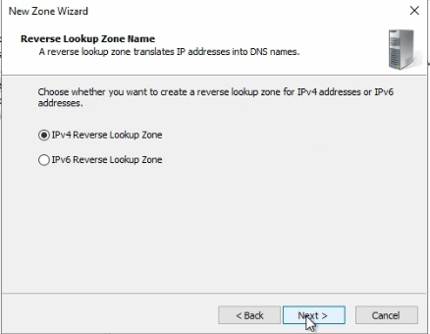
Create reverse lookup zone
Notes:
The zone replication scope will be the Domain
Since the scope is for IPv4 addresses we can keep the default.

Slide 5
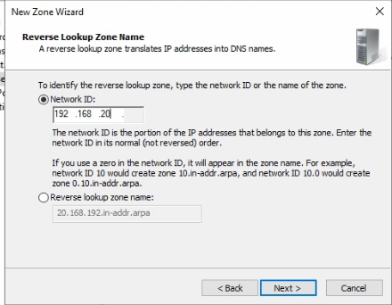
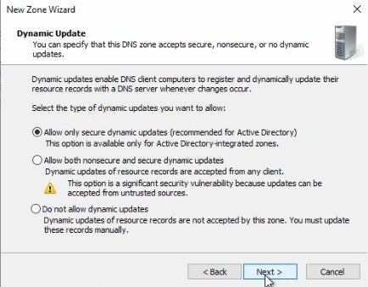
Create reverse lookup zone
Notes:
We need to enter the network ID for the IP range we are creating the zone.
Select Allow only secure dynamic updates

Slide 6
https://www.youtube.com/channel/UCcZ-jLbPwNr8E_v9-65n8Iw https://github.com/itknowledge4

